Slide 1
NGOs’ and NPOs’ Role in Humanitarian Crises
Institut Rafael Campalans
Anglès
06.05.2016
Notes:
INTRODUCCIÓ

Slide 2
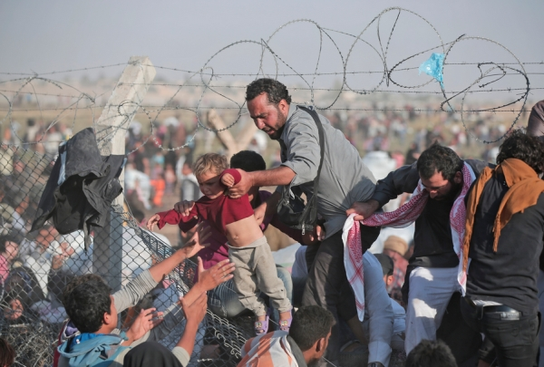
Current Situation

Slide 3

NGOS and NPOs

Slide 4
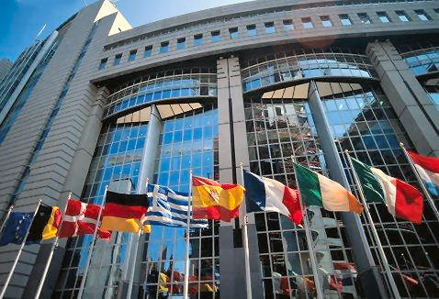
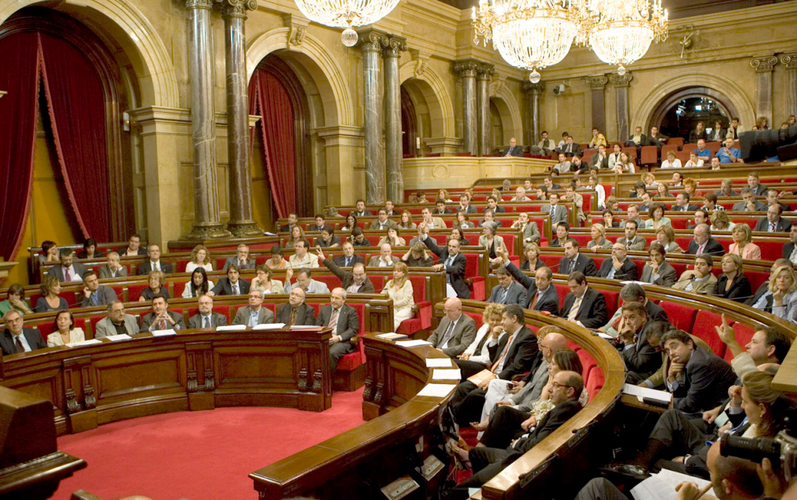
What should the states do and what are they doing?

Slide 5
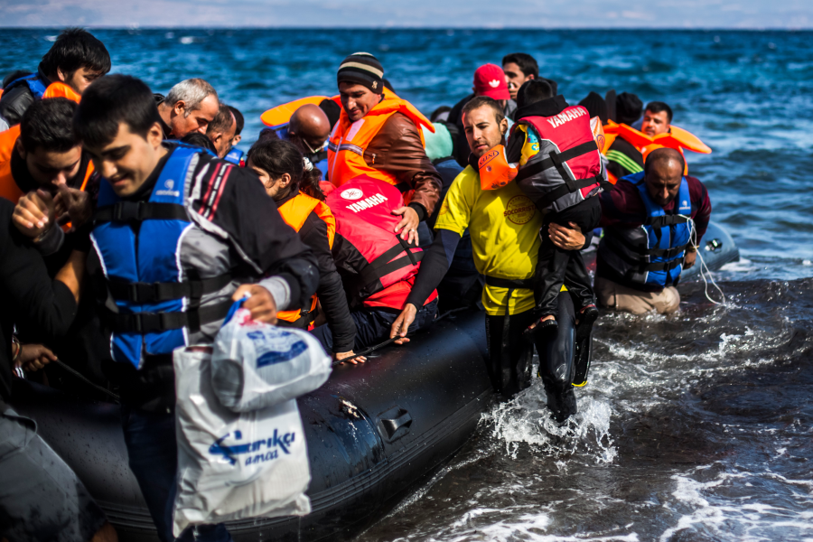
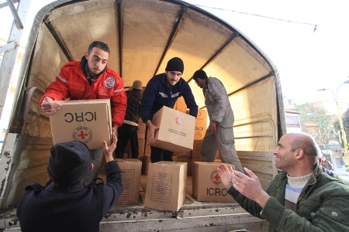
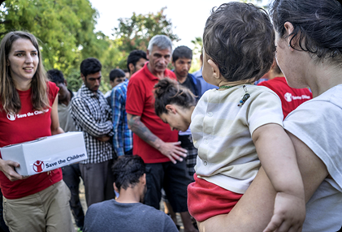
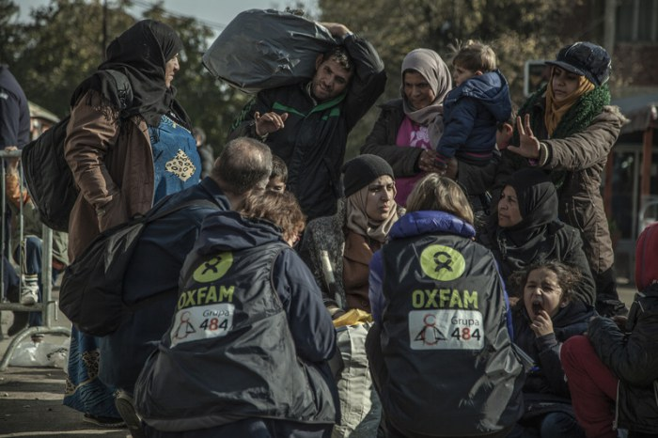
NGO’s role and their objective

Slide 6





NGOs examples

Slide 7
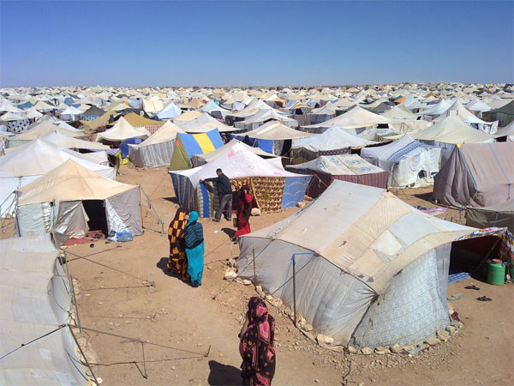
The intention of refugees and what they provide to the host country

Slide 8
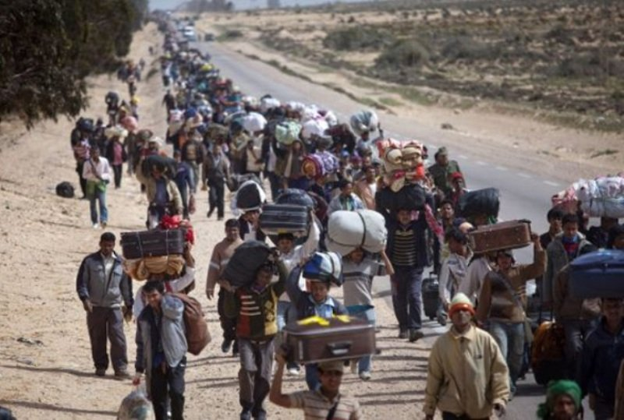
Conclusions

