Slide 1
Migrating into and around Europe

Slide 2
INTRODUCTION
Transoceanic emigration
Internal migration
Intercontinental immigration
Conclusion

Slide 3
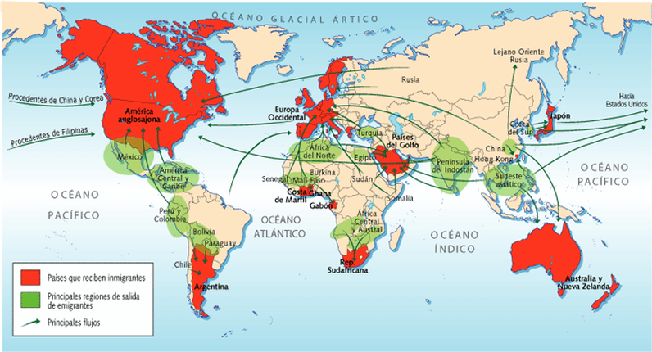
TRANSOCEANIC EMIGRATION

Slide 4
INTERNAL MIGRATION
Forced
Voluntaried
Economical & demographycal causes
The falling Soviet bloc

Slide 5
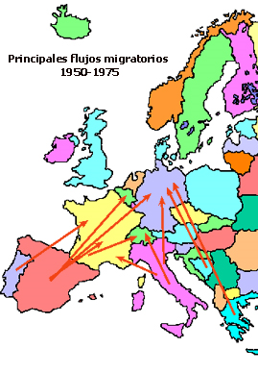
INTERNAL MIGRATION

Slide 6
INTERCONTINENTAL IMMIGRATION
Economical differences
European colons

Slide 7
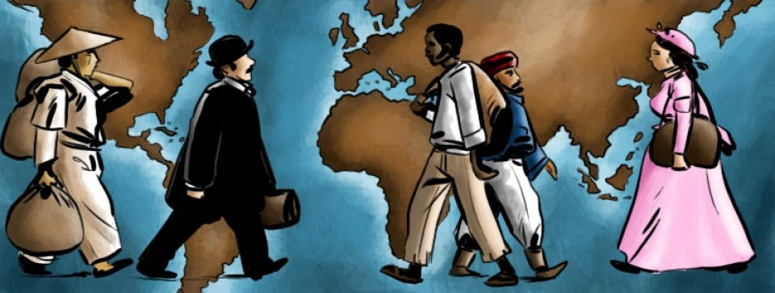
CONCLUSION

