Slide 1
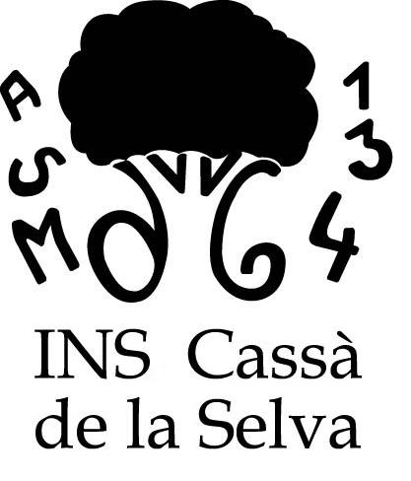
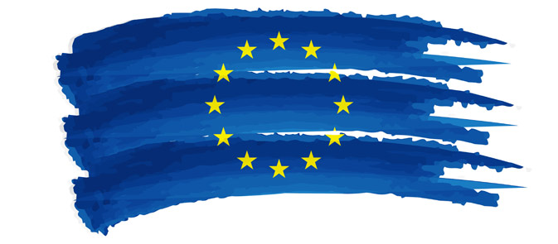
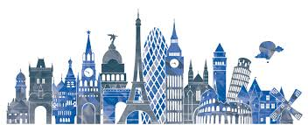
How to be European?
Institut de Cassà de la Selva
European Identity or Identities
Notes:
Lluís: First of all, we’d like to introduce ourselves we are Lluis, Bintou, Susana, Josep Maria and Laura and we come from Institut de Cassà de la Selva. There are 5 of us but we have been working on European Identities with a bunch of other people who are over there (Anna Li, Gemma, Kadi, Neus and Núria).
Laura: We will give our slideshow in English
Bintou: Et aussi en Français au début et a la fin. Bon, d’abord, merci à tous de nous écouter. On commence….
Laura: What distinguishes a European from a non-European? Is it the language? Is it the look? Is it our way of life? We hope you know it at the end of this presentation.
Bintou: Comment peut-on distinguer un Européen? C’est la langue? L’aparence? Le mode de vie? Vous le saurait, à la fin de la présentation… J’espère.

Slide 2
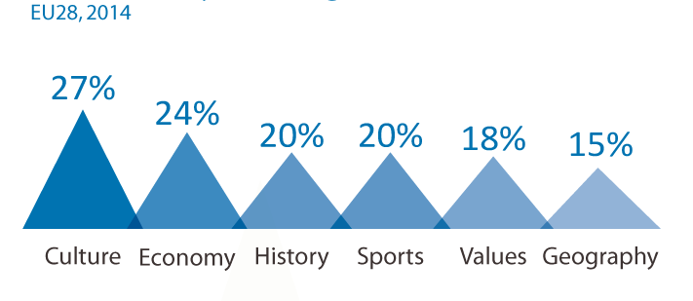
What makes us European...according to European Citizens?
Notes:
Josep Maria: What does it mean to be European? European Institutions are really interested in finding it out. For this reason, Eurostat, the EU agency for statistics and surveys, has asked this question to many European Citizens in the 28 member-states. According to their survey, what makes Europeans feel European is our shared Culture, our shared Economy, our shared History, our shared Sport competitions, Values and Geography.

Slide 3
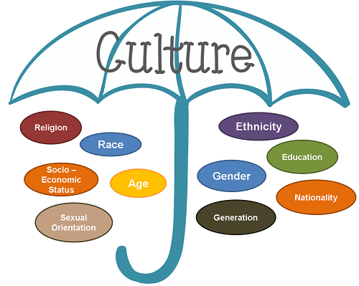
European Culture
Culture is the characteristics and knowledge of a group of people, defined by everything from language to religion, cuisine, social habits, music and arts.
LANGUAGE but…. 24 working languages + 5 semi-official + 20 minority languages.
RELIGION but 75% Europeans belief in God while 25% are atheists
OTHER ASPECTS not much in common...apparently.
Notes:
Lluís: As you can see, culture is set of characteristics and knowledge of a group of people, defined by everything from language to religion, cuisine, social habits, music and arts. Culture is like a big umbrella that covers almost everything…
Let’s talk about language in Europe, we have 24 working languages ( semi-official like Catalan and more than 20 minority languages).....not much in common.
Let’s talk about religion, 75% Europeans belief in God and 25% don’t. Believers are mainly Christian but other communities such as muslims and hinduists more and more important….not much in common.
We could talk about gender, ethnicity, age, sexual orientation and always the same conclusion: not much in common….

Slide 4
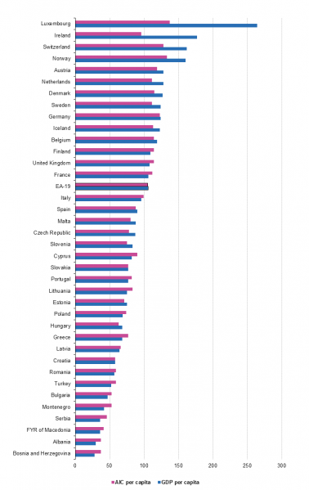
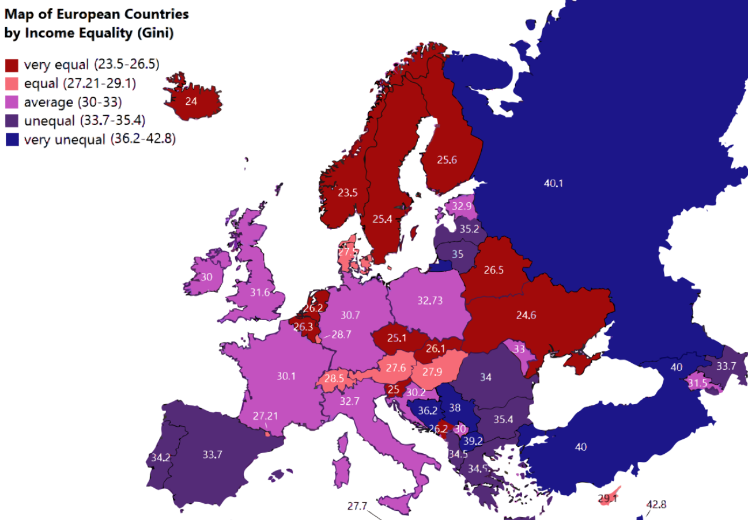
Economy
The EU is the 2nd World economic power
Unequal distribution among states but also among citizens.
Notes:
Susanna: Let’s talk about money! Europeans are rich. The EU is the second world economic power and the first trading power.
But …. some countries are richer than others (Look at Luxemburg and at Bulgaria) In EU words, The dispersion in GDP per capita across the EU Member States is quite remarkable) And some Europeans are richer than others: In countries in red, unequality is lesser than in countries in purple or blue.

Slide 5
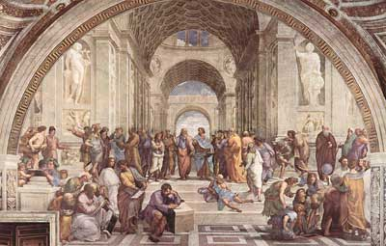
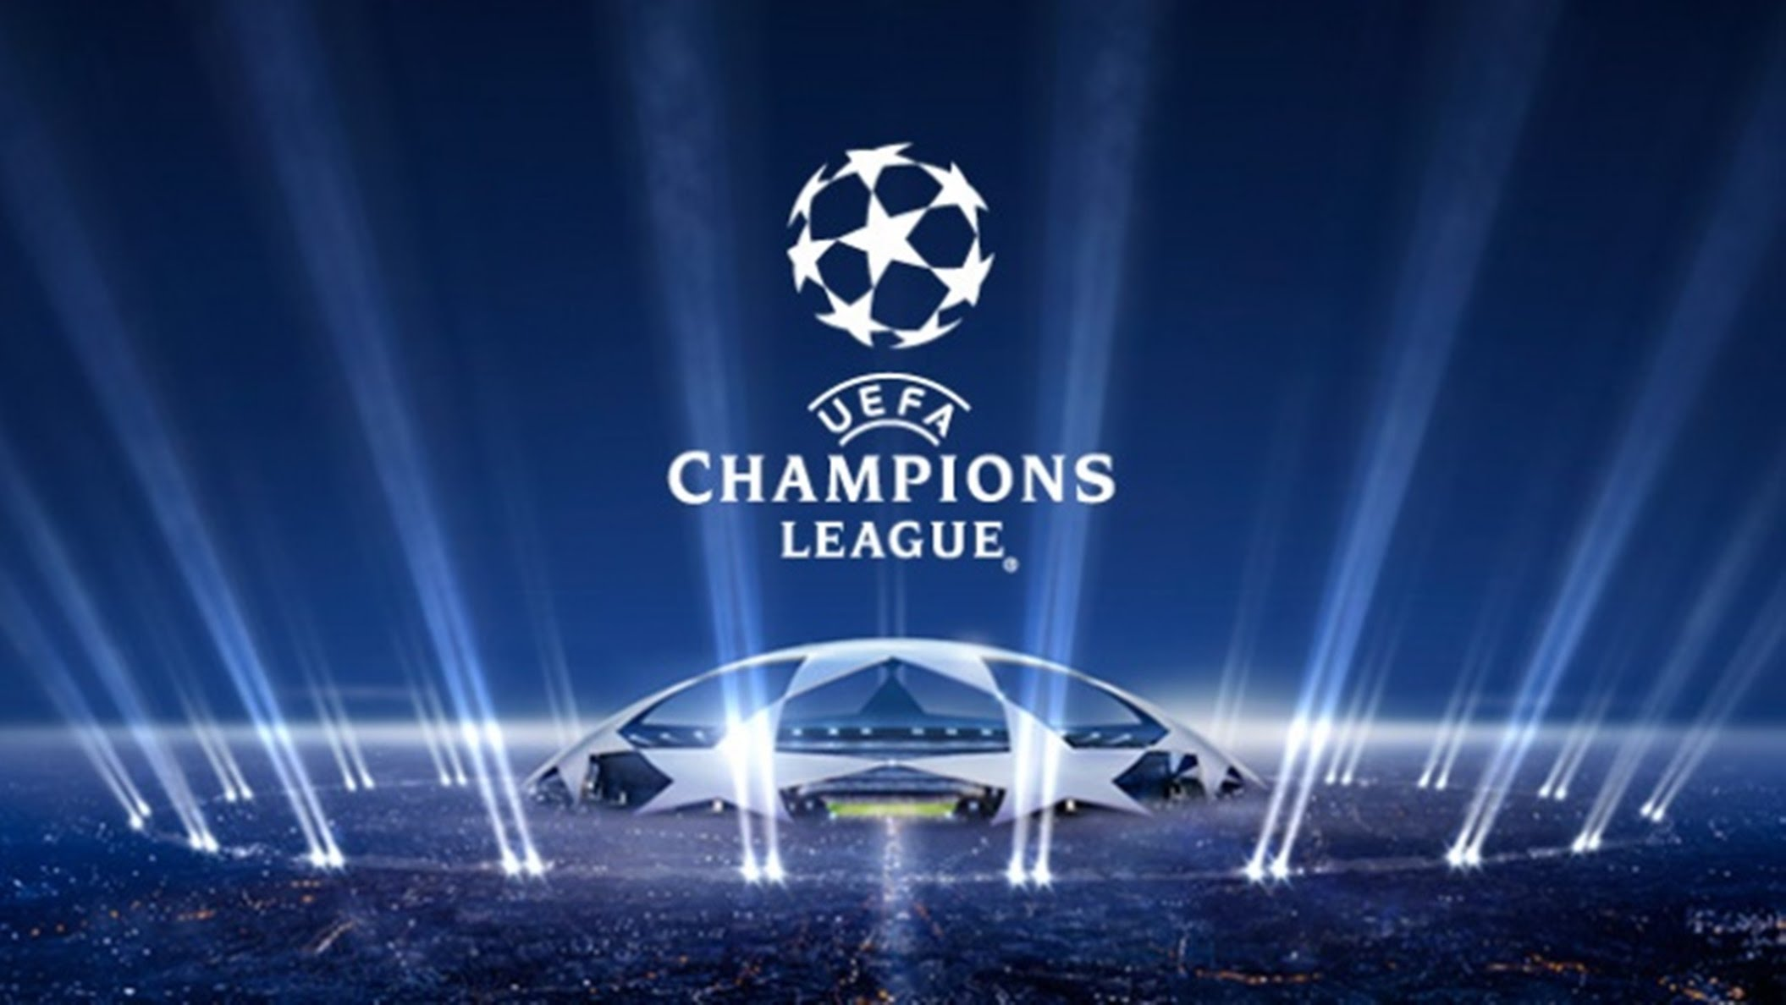
History, sports and so on...
Notes:
Laura: True. We share a long common history. Ever more, Europe created history! We created civilizations like Greece and Rome. Europe created philosophy and also create science…. Europe even created football! The truth is that Europe has invented, created and made many great things and THAT IS ONE THING WE HAVE IN COMMON..

Slide 6
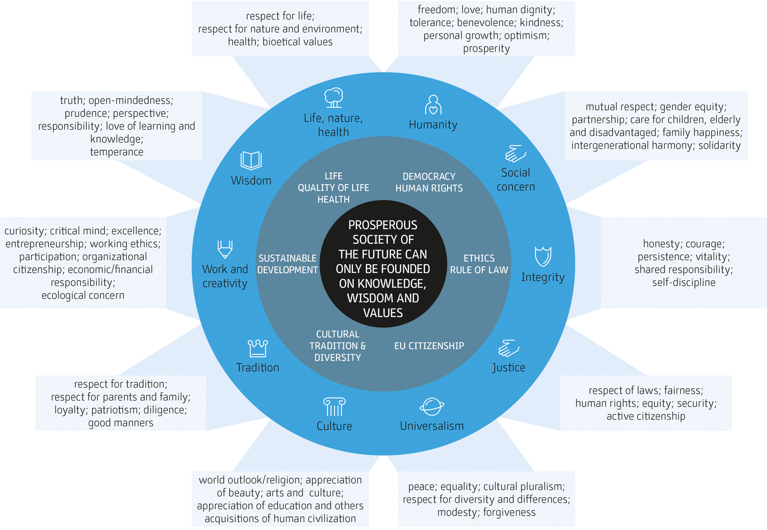
European view of the world
Notes:
Josep Maria: And here we come to the key point. Being European means sharing a certain view of the world. Europeans believe that the prosperous society of the future can only be founded on knowledge, wisdom and values. These values are: WISDOM WORK, CREATIVITY TRADITION CULTURE UNIVERSALISM JUSTICE INTEGRITY SOCIAL CONCERN HUMANITY LIFE, NATURE, HEALTH.

Slide 7
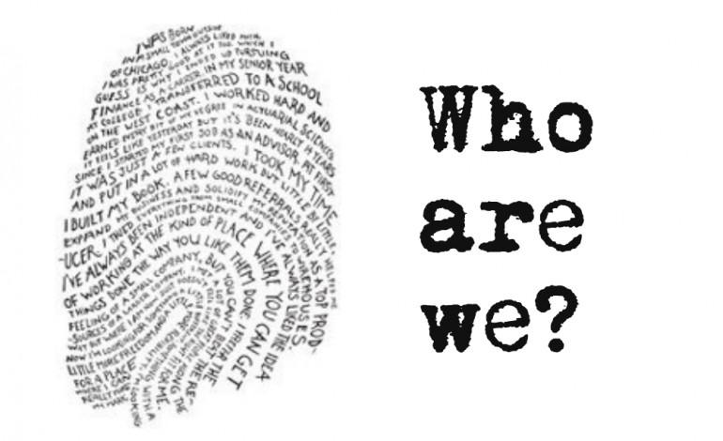
Identity or Identities
Notes:
Lluís: So far, we have seen that Europeans do not have so much in common and however they believe they do. At the beginning when we explained what is culture is the characteristics of a group AS WELL AS the knowledge of being a group.
Europeans identify themselves as such, because they share a continent, a long history, a set of values but mainly BECAUSE THEY WANT TO. .

Slide 8
In conclusion
Europeans have a common history, geography, economy and view of the world.
Europeans identify themselves as such and identify themselves with a set of core genuinely European values.
European share joint symbols, traditions and other cultural elements and believe in a joint future they want to share.
Notes:
As finishing words, let’s say that
Europeans have a common history, geography, economy and view of the world.
Les européens partagent une histoire, une géographie, une économie et une vision du monde.
Europeans identify themselves as such and identify themselves with a set of core genuinely European values.
Les européens se disent européens et ils s’identifient avec des valeurs fondamentales partagées.
European share joint symbols, traditions and other cultural elements and believe in a joint future.
Les européens ont des symboles communs ainsi que d’autres éléments cultures et ils croient à un futur ensemble.
Thank you for your attention. Merci de votre atténtion.

